Slide 1



Sign up for HealthCheck by scanning the QR code to the left.
Apple iPhone users can scan using the camera function.
All other users should use a QR code scanner.

Slide 2
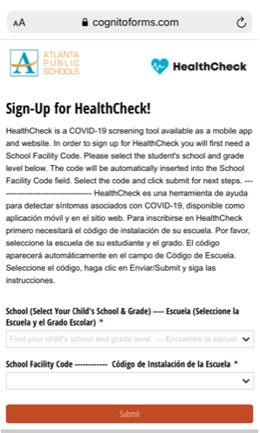
You should see a screen like the one to the left.

Slide 3
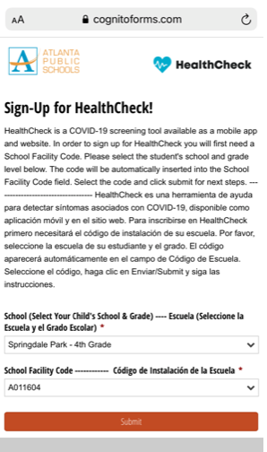
Select your child’s school and grade level using the first drop down menu.
Select the School Facility Code shown in the next drop down menu.
RECORD this code. You will need it when you register on the next screen.

Slide 4
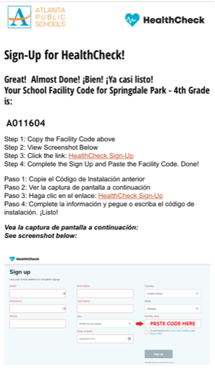
Sign up for an account.
This should be your contact information (email and cell phone) with your student’s name, birthdate and gender.
Click sign up!
You will receive a verification link at the email you used to sign up.
Go to your email and click ACTIVATE.

Slide 5
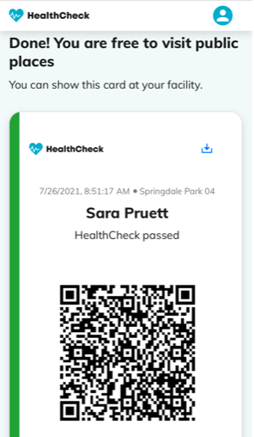
Once you have activated your account and logged in using the information you selected during sign up, you can complete a health screening for your child.
Once the screening is passed, you will see a QR code.

Slide 6
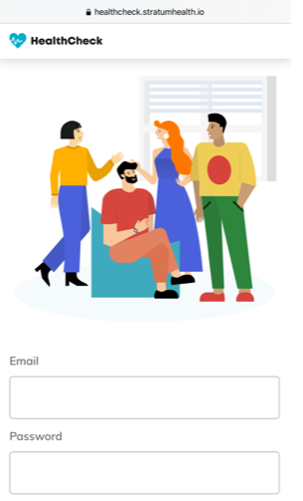
To complete the health screening, the next school day, return to the website:
https://healthcheck.stratumhealth.io/#/login?returnUrl=%2Fhome
Log in using the email and password you selected.

Slide 7

Click on Check Health to complete the student screening questions.

